Slide 1
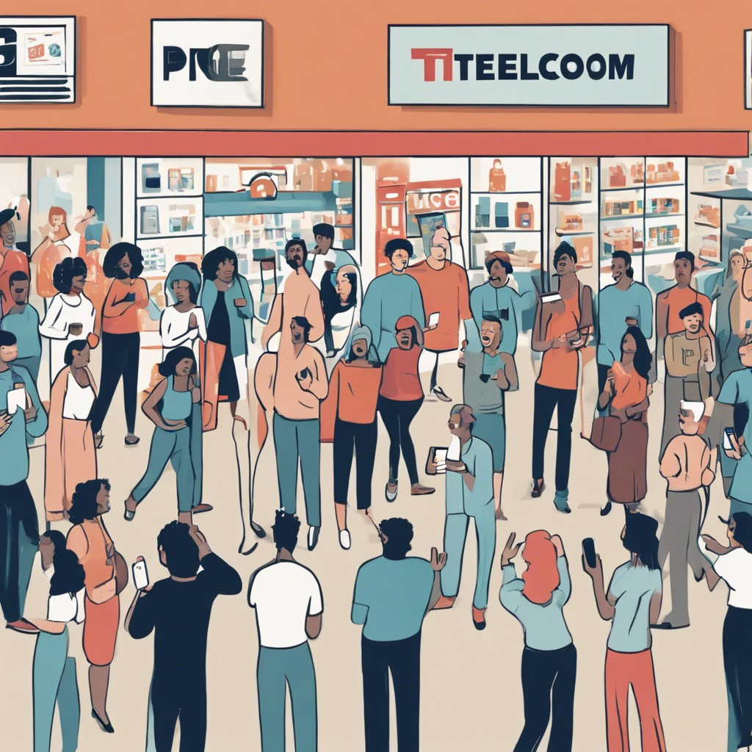
CONNETTEL Customer
Churn Prediction: A Data-Driven Approach to Predicting Churn Using Machine Learning.
By
Ernest Udoudo

Slide 2

PROBLEM OVERVIEW
ConnectTel Telecom Company faces the pressing need to address customer churn, which poses a significant threat to its business sustainability and growth.
The company's current customer retention strategies lack precision and effectiveness, resulting in the loss of valuable customers to competitors.
To overcome this challenge, ConnectTel aims to develop a
robust customer churn prediction system for which you have been contacted to handle as a Data Scientist By leveraging advanced analytics and machine learning techniques on available customer data, the company seeks to
accurately forecast customer churn and implement targeted retention initiatives.
This proactive approach will enable ConnectTel to reduce customer attrition, enhance customer loyalty, and maintain a competitive edge in the highly dynamic and competitive telecommunications industry.

Slide 3
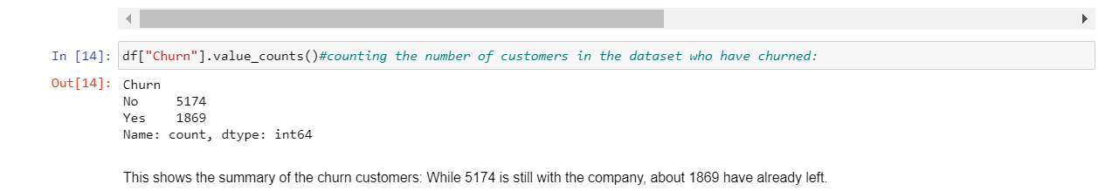
Only around 27% of the customers in the dataset have churned. This means that we are dealing with an imbalanced classification problem. We will need to perform some feature engineering to create a balanced training dataset before building the predictive model.

Slide 4
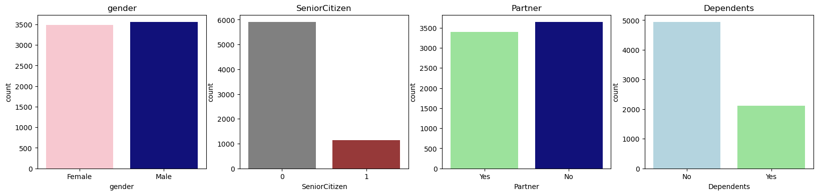
Most customers in the dataset are younger individuals without a dependent. There is an equal distribution of user gender and marital status.

Slide 5
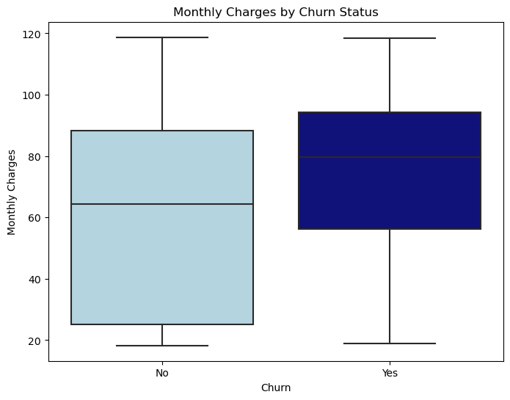
The assumption above is true. Customers who churned have a higher median monthly charge than customers who renewed their subscriptions.

Slide 6
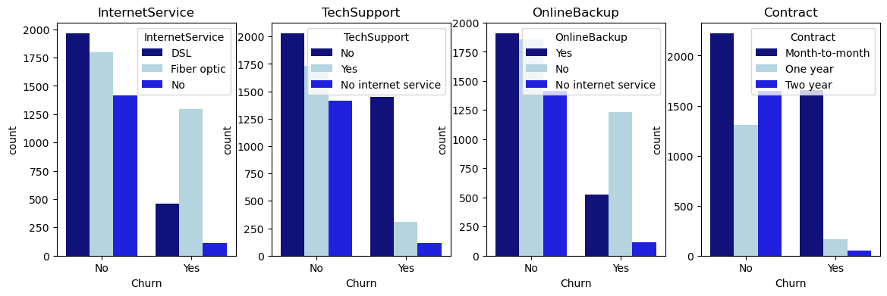
The analysis identifies key factors contributing to customer churn:
1.InternetService: Customers using fiber optic Internet are more likely to churn, possibly due to high costs or inadequate coverage.
2.TechSupport: Many churned users didn't utilize tech support, suggesting unresolved technical issues as a churn driver.
3.OnlineBackup: Churned customers often lacked online backup services, indicating a need for better data protection measures.
4. Contract Type: Churn was prevalent among users on monthly contracts, likely due to the ease of cancellation.
Data-driven insights are crucial for understanding churn patterns. Addressing issues such as the lack of tech support can inform targeted retention strategies, like offering complimentary support services. Ultimately, businesses must proactively tackle churn to enhance customer satisfaction and long-term profitability.

Slide 7
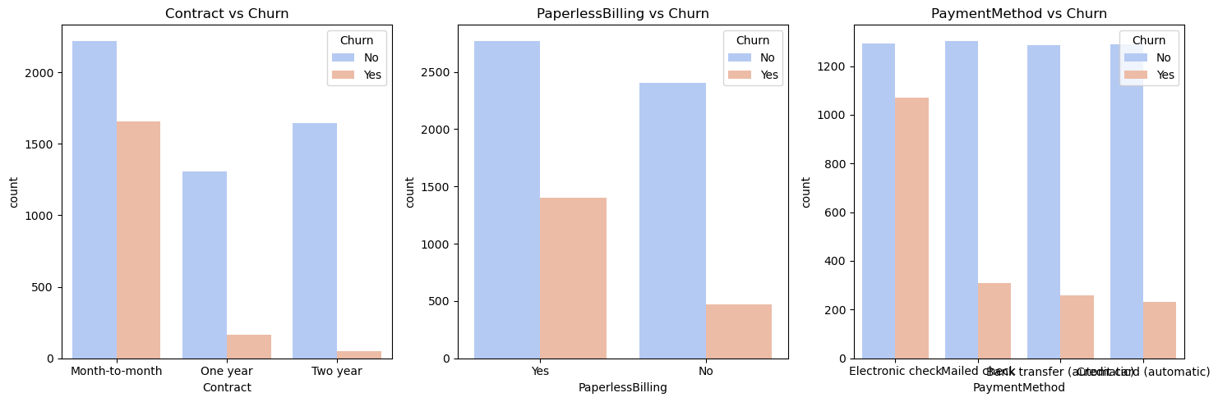
The analysis reveals that different contract types, paperless billing, and payment methods are associated with varying churn rates, suggesting the need for tailored retention strategies. Cross-tabulations highlight specific customer segments more likely to churn based on combinations of these variables, providing valuable insights for targeted retention efforts.

Slide 8
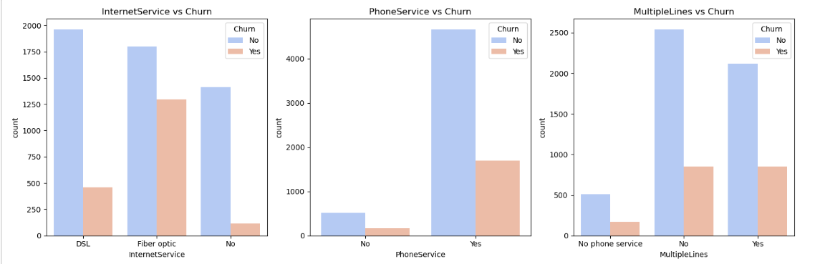
The multivariate analysis examines the relationship between Internet service type, phone service, multiple lines, and churn through count plots and cross-tabulations. The count plots visually compare churn rates across different service types, while the cross-tabulations provide deeper insights into how combinations of these services relate to churn, offering valuable information for targeted retention strategies.

Slide 9
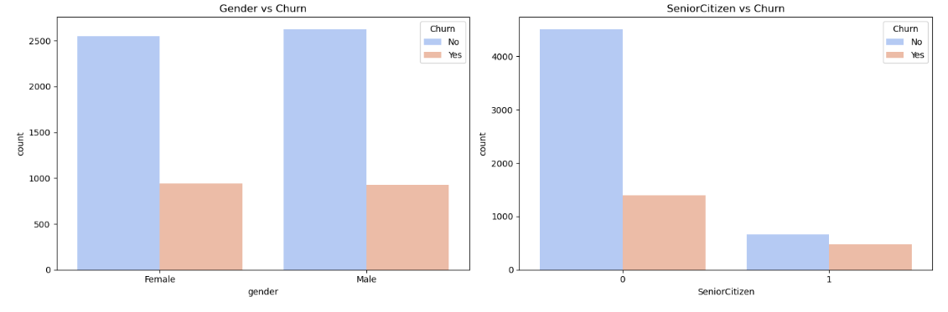
The analysis examines the impact of gender and senior citizenship status on churn through count plots, while also considering the presence of online security and tech support services. The cross-tabulations likely provide deeper insights into how these variables in combination relate to churn, offering valuable information for targeted retention strategies.

Slide 10
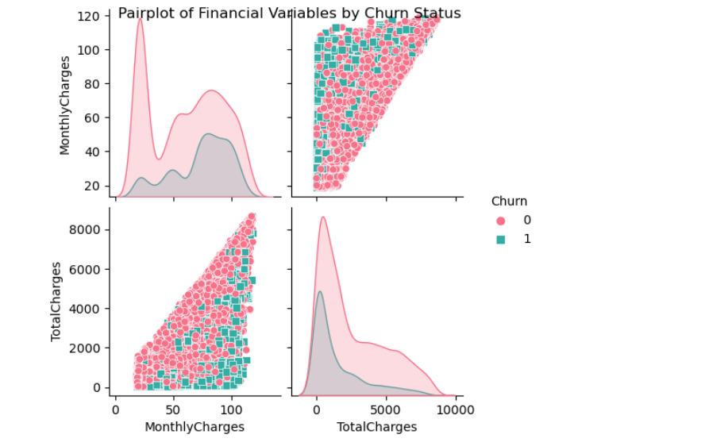
Financial Variables Vs Churn
The multivariate analysis of financial variables explores the relationships between monthly charges, total charges, and churn using a scatterplot matrix. This visualization aims to identify any discernible patterns or trends in the financial variables in relation to churn status, providing insights into the potential impact of financial factors on customer churn.

Slide 11
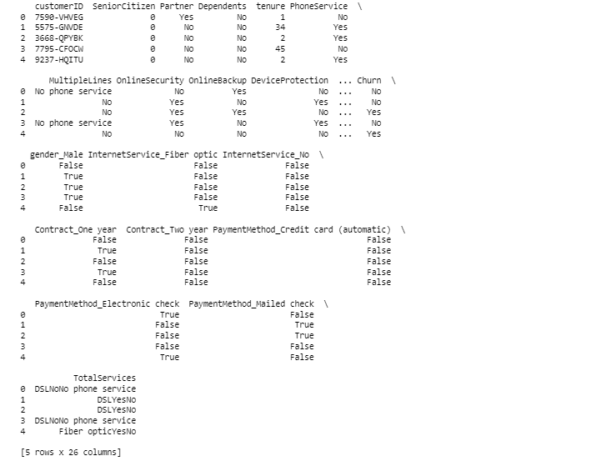
Encoding Categorical Variables
This table utilizes one-hot encoding to transform categorical variables into a format suitable for machine learning models, expanding the organization's ability to utilize these variables in predictive analytics. Additionally, it demonstrates the creation of new features, such as the total number of services subscribed to, providing the organization with enhanced data representation for more comprehensive analysis and model development.

Slide 12
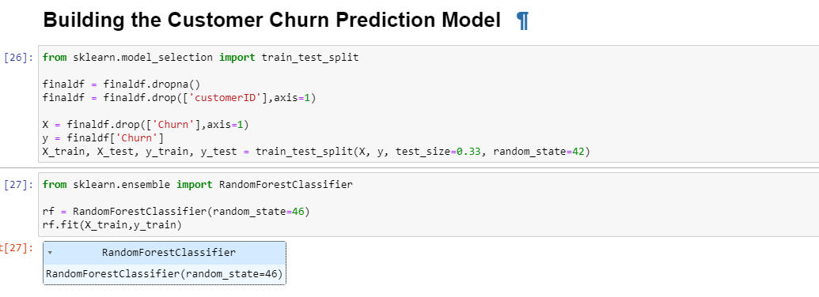
RandomForestClassifier was used to for predicting because it excels in accuracy and robustness by combining decision trees, handling various data types, and revealing feature importance. Its scalability and ease of use make it a versatile and powerful choice for organizations seeking accurate predictive models for classification tasks.

Slide 13

Retention Strategies
To establish a loyal customer base, Connecttel Company should offer a simple and cost-effective way for customers to start using their services. During the first six months, the company should prioritize providing strong Online Security, Online Backup, Device Protection, and Tech Support, as this initial period is crucial and unpredictable for customers. The goal is to reduce the average length of time customers stay with these services from 40 to 50 months.

Slide 14
Conclusion
Churning is an ongoing trend in most firms around the tech world. However, a data-driven approach to predicting these churns is instrumental in optimizing customer retention strategies.
By harnessing the power of data and analytics, organizations can enhance customer loyalty and long-term proﬁtability.
The dataset is an incredible one and my constraint was time management due to work and family affairs.

Slide 15
Thanks!
Do you have any questions? ernestuwem@gmail.com
+2348032627766

